Slide 1
Coffee Shops in Toronto
An analysis

Slide 2
The problem
One of the greatest challenges to someone who wants to start their own cafe is to decide its location. A lot of factors play into this decision, but one of the most important elements to consider is the placement of its competition.
The aim is to help with this decision using data science.

Slide 3
Data Requirements
The requirements are as follows:
Cafes/coffee shops in the city of interest (Toronto)
Location of the cafe in the form of its Latitude and Longitude coordinates.

Slide 4

Data Sourced from:
Foursquare API calls

Slide 5
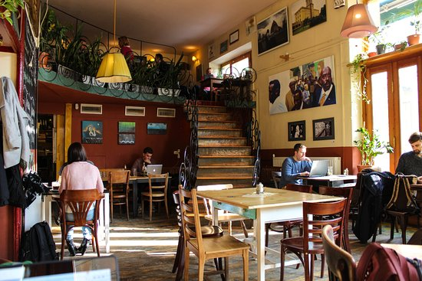
Where are the coffee shops located?

Slide 6
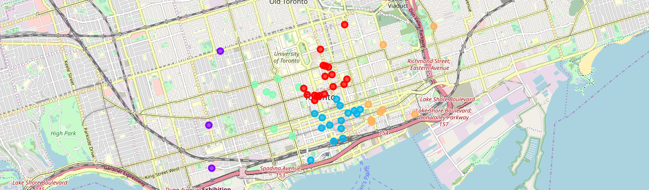
Divided into 5 clusters:

